Slide 1

HOUSE RENT PRICE PREDICTION
Group Members
Bhavneet Kaur
Namita

Slide 2
Overview
Introduction
Dataset Overview
Data Preprocessing
Exploratory Data Analysis
Visualization
Feature Engineering
Model Evaluation
Best Performing Model
Future Enhancements
Conclusion

Slide 3

INTRODUCTION
Brief introduction to the project: Our project focuses on predicting house rent prices using machine learning models. By leveraging various explanatory variables related to residential houses, we aim to develop a model that accurately estimates rent prices.
Objectives of the project: The primary objective of our project is to minimize the difference between the actual rent prices and the prices estimated by our machine learning model. This involves training the model on historical data and evaluating its performance using relevant metrics.
Importance of predicting house rent prices accurately: Accurately predicting house rent prices has significant implications for both landlords and tenants. Landlords can set competitive rental rates to maximize their returns, while tenants can make informed decisions about their housing choices based on fair market prices. Additionally, accurate rent price predictions contribute to a more efficient and transparent rental market.

Slide 4

DATASET OVERVIEW
Source of the dataset: The dataset used in our project is sourced from Kaggle. It consists of various attributes describing residential properties, along with their corresponding rent prices.
Number of features: The dataset comprises a total of 30,000 rows and 22 features, including both numerical and categorical variables. These features capture different aspects of residential properties, such as size, location, amenities, and more.
Target variable (Rent Price): The variable we aim to predict is the rent price of the houses. This variable serves as the focal point of our machine learning modeling efforts.

Slide 5

Data preprocessing
In this step, we prepared the dataset for analysis by addressing missing values and outliers:
Missing value imputation:
Parking options and laundry options were filled with the mode value of the respective house type.
Latitude and longitude were filled with the mode values of respective house regions.
Records with missing state and description were dropped.
Outlier removal using interquartile range technique.
Log transformation applied to skewed numerical variables to improve distributional properties.

Slide 6

Exploratory Data Analysis (EDA)
Analyzing Numerical and Categorical Variables:
Examining distributions, central tendency, and dispersion of numerical variables.
Exploring frequency distributions and outliers in categorical variables.
Exploring Relationships Between Features:
Visualizing interactions through scatter plots and stacked bar charts.
Understanding dependencies and correlations among variables.
Identifying Potential Trends and Anomalies:
Detecting trends, patterns, and anomalies through visualization and statistical analysis.
Uncovering underlying data structures and inconsistencies.
Preparing for Subsequent Tasks:
Selecting relevant features and preprocessing steps.
Validating assumptions and guiding modeling efforts.

Slide 7
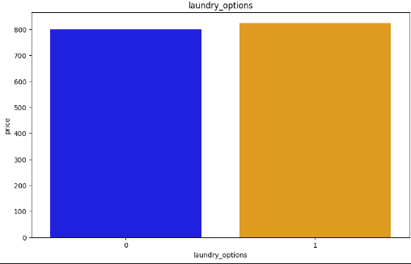
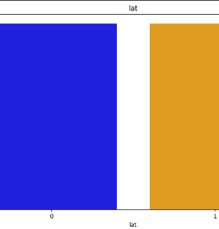
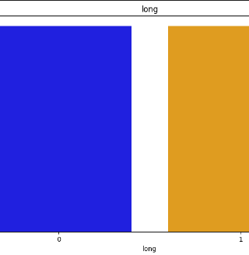
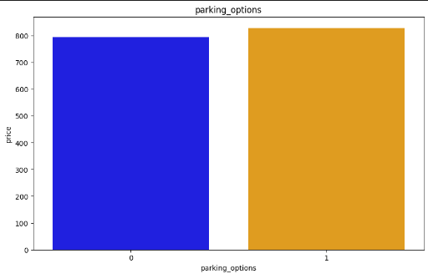
Visualization
Bar Plot: Analyzes missing values in a variable, converts missingness to binary, then plots median price, compares missing vs. non-missing observations.

Slide 8
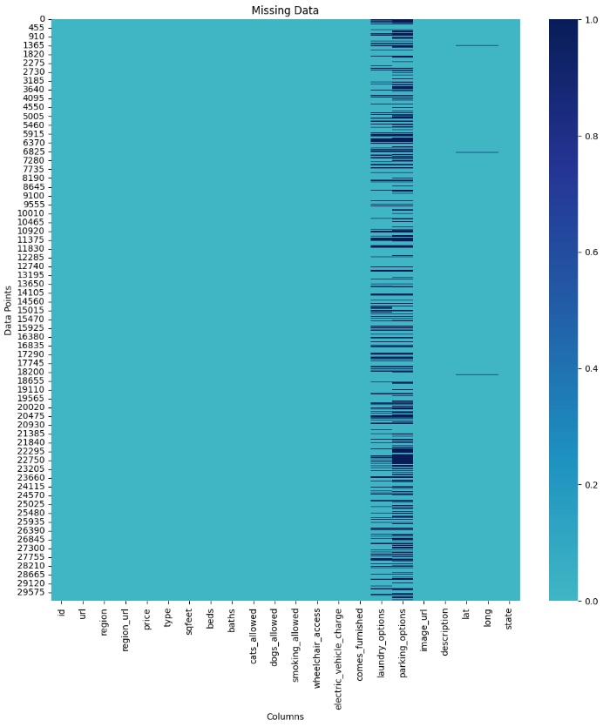

Heat Map of Missing Data: displays missing values in dataset, darker shades indicate higher missingness, guides data preprocessing strategies.

Slide 9
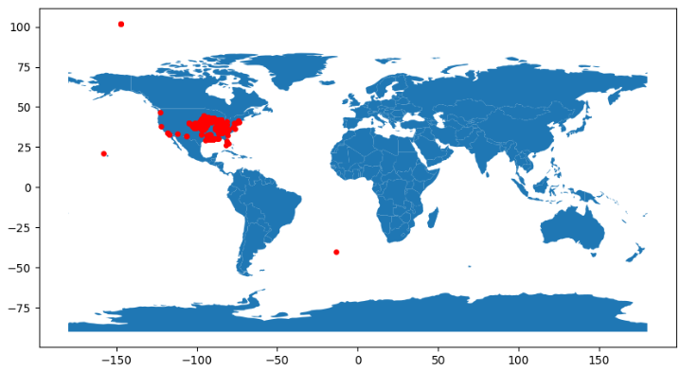
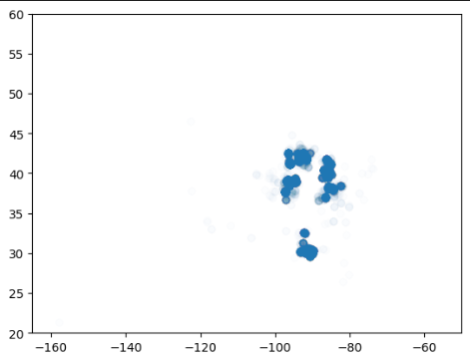
Shapely Geometry for Geospatial Visualization: Utilizes Shapely to create point geometries from latitude and longitude, GeoDataFrame overlayed on a world map using GeoPandas, Red markers denote data points on the map, aiding spatial analysis.
Scatter Plot: Scatter plot of latitude and longitude data, Provides spatial distribution insights, Adjusted alpha for data density, and limits for better visualization.

Slide 10
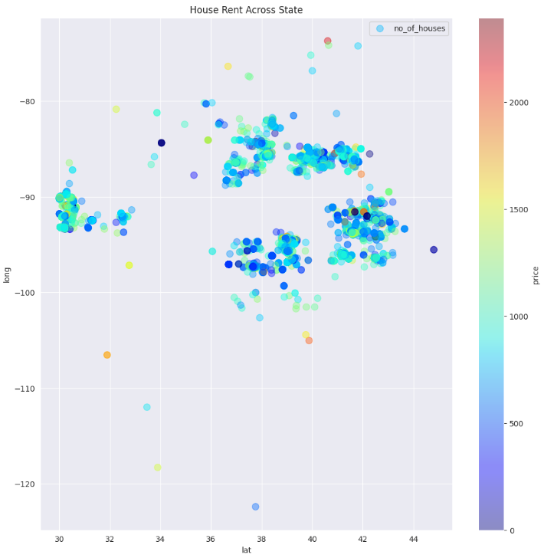
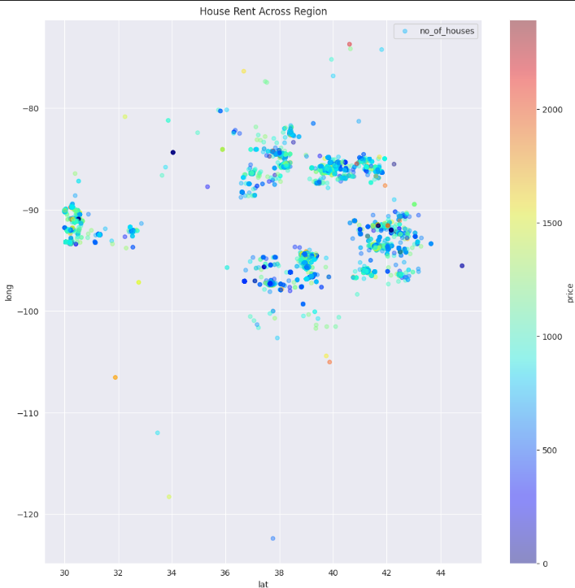
House Rent Across State: Scatter plot illustrating house rent distribution across different states. Circle sizes represent the number of houses in each state, while color intensity indicates rent prices.
House Rent Across Region: Scatter plot showing house rent distribution across various regions. Circle sizes depict the number of houses in each region, with color indicating rent prices.

Slide 11
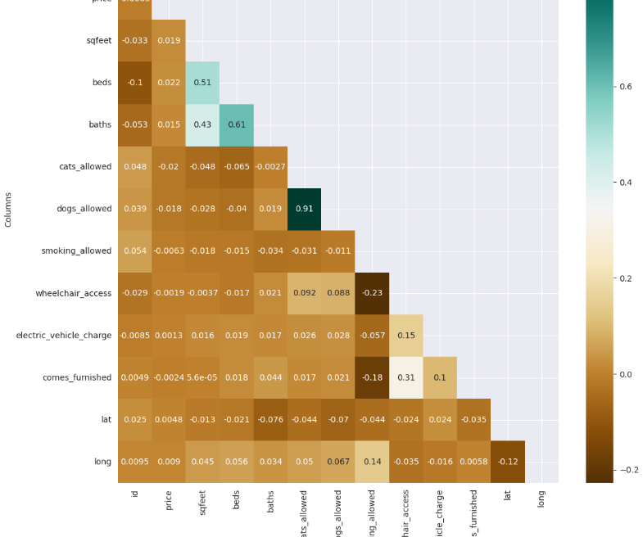
Feature Correlation Heatmap
Displays the correlation matrix among numerical features.
Interpretation: Strength and direction of correlations depicted through color intensity and annotations.

Slide 12
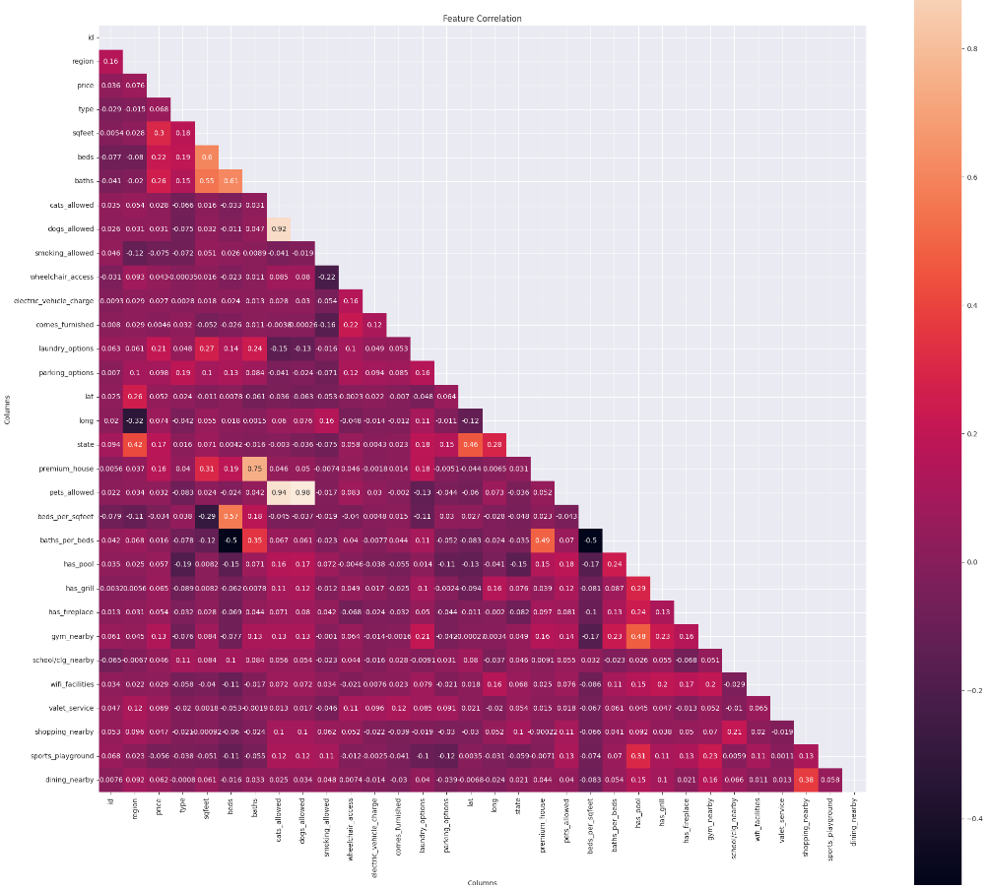
Feature engineering
Feature Engineering: Adding new features like 'premium_house', 'pets_allowed', 'beds_per_sqfeet', 'baths_per_beds', etc., to enrich the dataset. Exploring and extracting insights from the 'description' column to create features indicating amenities like pool, grill, fireplace, gym, etc.
Numerical Variable Transformation: Log transforming positive numerical variables such as 'price', 'sqfeet', 'baths_per_beds', and 'beds_per_sqfeet' for better model performance.
Categorical Variable Encoding: Transforming categorical variables into numerical form, preserving monotonic relationships with the target variable. Handling rare labels and encoding categorical variables using ordinal encoding for improved model interpretability.
Correlation Heatmap: Visualizing the correlation between features using a heatmap, aiding in understanding relationships and identifying potential multicollinearity.

Slide 13
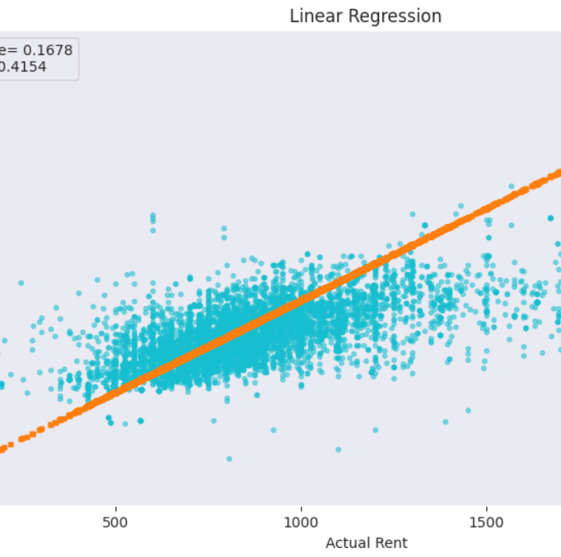
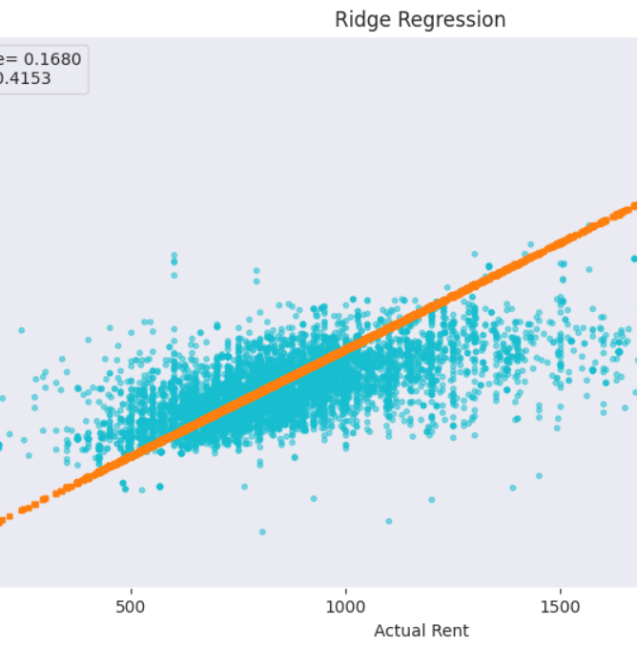
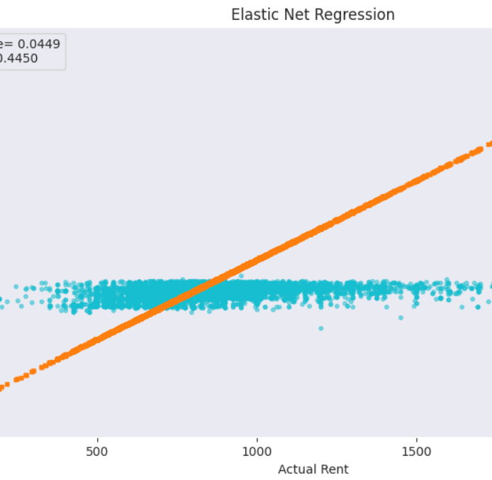
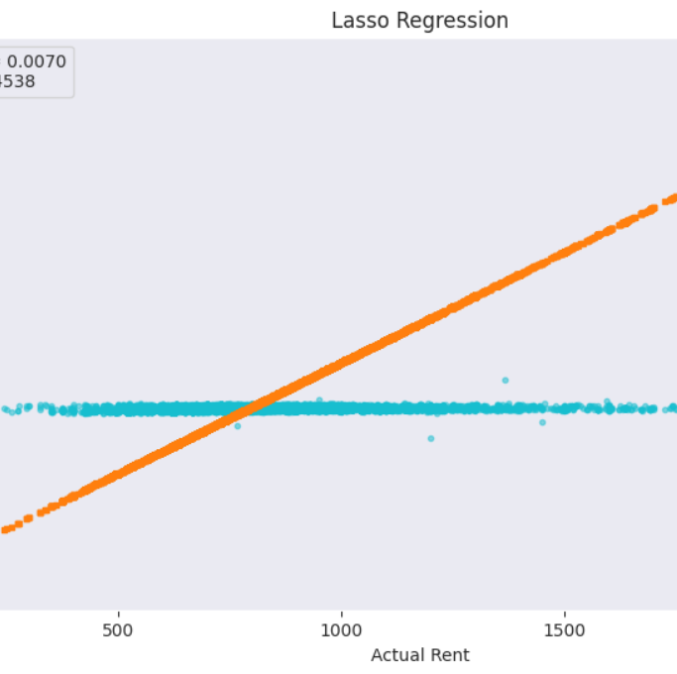
MODEL EVALUATION
Linear Regression: Mean Absolute Error (MAE): 0.177, Root Mean Squared Error (RMSE): 0.415, R2 Score: 0.168
Ridge Regression: MAE: 0.177, RMSE: 0.415, R2 Score: 0.168
Elastic Net Regression: MAE: 0.216, RMSE: 0.445, R2 Score: 0.045
Lasso Regression: MAE: 0.229, RMSE: 0.454, R2 Score: 0.007

Slide 14
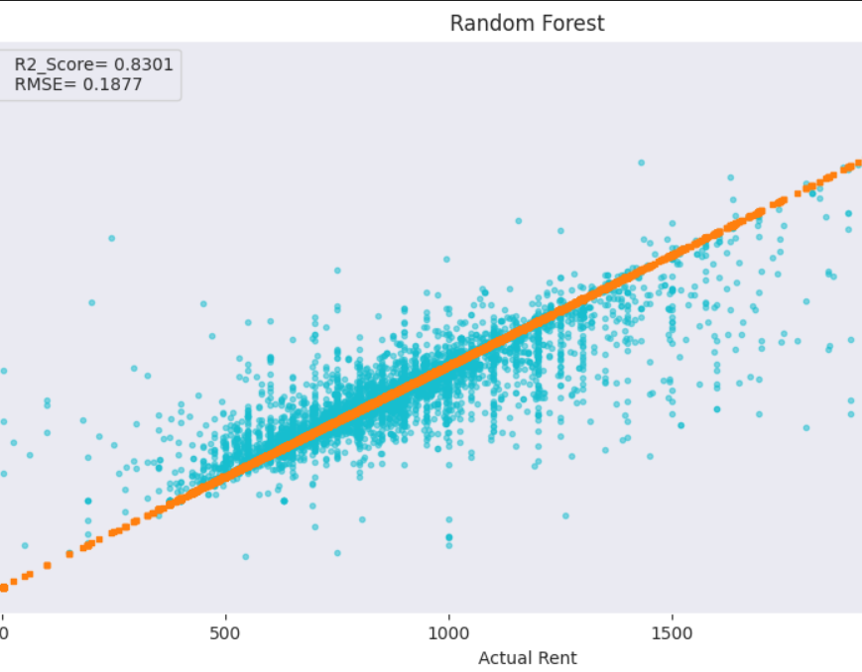
Best Performing Model
The Random Forest model's performance on the test set is as follows:
Mean Absolute Error (MAE): 0.059
Root Mean Squared Error (RMSE): 0.188
R-squared (R2) Score: 0.830

Slide 15
Future enhancements
Feature Engineering: Explore additional feature engineering techniques to uncover new insights and improve model performance. This could involve creating new features, transforming existing ones, or leveraging domain knowledge for better representation of the data.
Advanced Modeling Techniques: Experiment with more sophisticated modeling techniques such as ensemble methods, gradient boosting algorithms, or neural networks. These approaches may capture complex relationships in the data that simpler models struggle to discern.
Hyperparameter Tuning: Conduct extensive hyperparameter tuning to optimize the performance of existing models. This process involves systematically searching for the best combination of model parameters to enhance predictive accuracy and generalization.
Ensemble Learning: Implement ensemble learning techniques to combine predictions from multiple models. Ensemble methods like stacking, bagging, and boosting can often yield better results by leveraging the strengths of individual models and mitigating their weaknesses.
Regularization Techniques: Investigate the use of advanced regularization techniques such as dropout, L1/L2 regularization, or early stopping to prevent overfitting and improve model generalization on unseen data.

Slide 16

Conclusion
Model Performance: We observed varying performance among different regression techniques. While Random Forest exhibited the best performance with a low MAE of 0.059 and a high R2 score of 0.830, other models such as Linear Regression and Lasso Regression showed comparatively weaker performance.
Room for Improvement: Despite the promising results of Random Forest, there is still room for improvement in our predictive models. Techniques such as feature engineering, hyperparameter tuning, and ensemble methods could potentially enhance the accuracy and robustness of our predictions.
ANN Implementation: The implementation of Artificial Neural Networks (ANN) provided competitive results, indicating the potential of deep learning approaches in this domain. However, further experimentation and optimization are necessary to fully harness the power of ANN for rent prediction.
Future Directions: Moving forward, we aim to explore advanced modeling techniques, including ensemble methods like Gradient Boosting and XGBoost, as well as deep learning architectures like Convolutional Neural Networks (CNN) and Recurrent Neural Networks (RNN).

Slide 17


Thank you

